Slide 1
Image Steganography using Matlab
Parth Bansal (PES1201801325)
Akash G (PES1201801970)
Shravan Kumar V.R (PES1201801076)

Slide 2

Introduction
Steganography is the technique of hiding secret data within an ordinary, non-secret, file or message in order to avoid detection; the secret data is then extracted at its destination. The word steganography is derived from the Greek words steganos (meaning hidden or covered) and the Greek root graph (meaning to write).
Types of Steganography include:
Image Steganography
Video Steganography
Audio Steganography
Document Steganography

Slide 3

Image Steganography
As the name suggests, Image Steganography refers to the process of hiding data within an image file. The image selected for this purpose is called the cover-image and the image obtained after steganography is called the stego-image.
By applying the encrypted data to this redundant data in some inconspicuous way, the result will be an image file that appears identical to the original image because the LSB value of the of the pixel is where the data is encrypted but that has "noise" patterns of regular, unencrypted data.

Slide 4
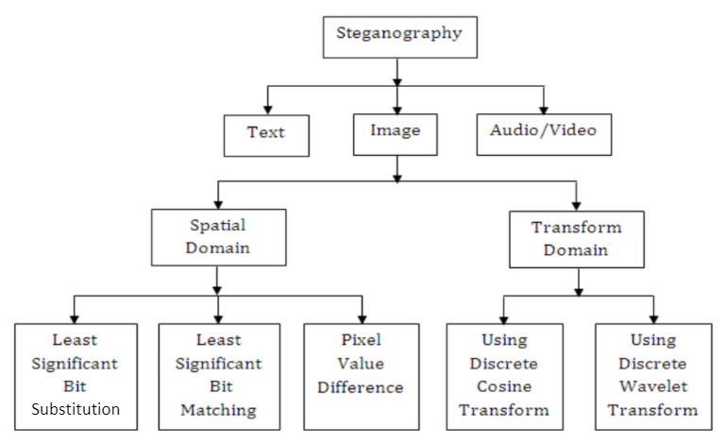
Flowchart

Slide 5
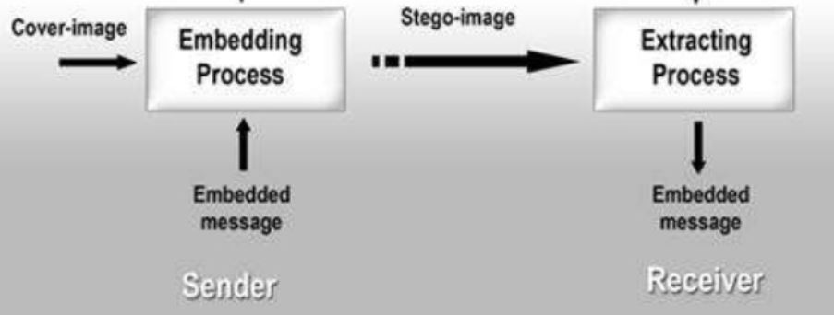

Slide 6
Algorithm
Least Significant Bit (LSB) method method:
Convert the image to grayscale
Resize the image if needed
Convert the message to its binary format
Initialize output image same as input image

Slide 7
5. Traverse through each pixel of the image and do the following:
Convert the pixel value to binary
Get the next bit of the message to be embedded
Create a variable temp
If the message bit and the LSB of the pixel are same, set temp = 0
If the message bit and the LSB of the pixel are different, set temp = 1
This setting of temp can be done by taking XOR of message bit and the LSB of the pixel
Update the pixel of output image to input image pixel value + temp
6. Keep updating the output image till all the bits in the message are embedded
7. Finally, write the input as well as the output image to local system.

Slide 8
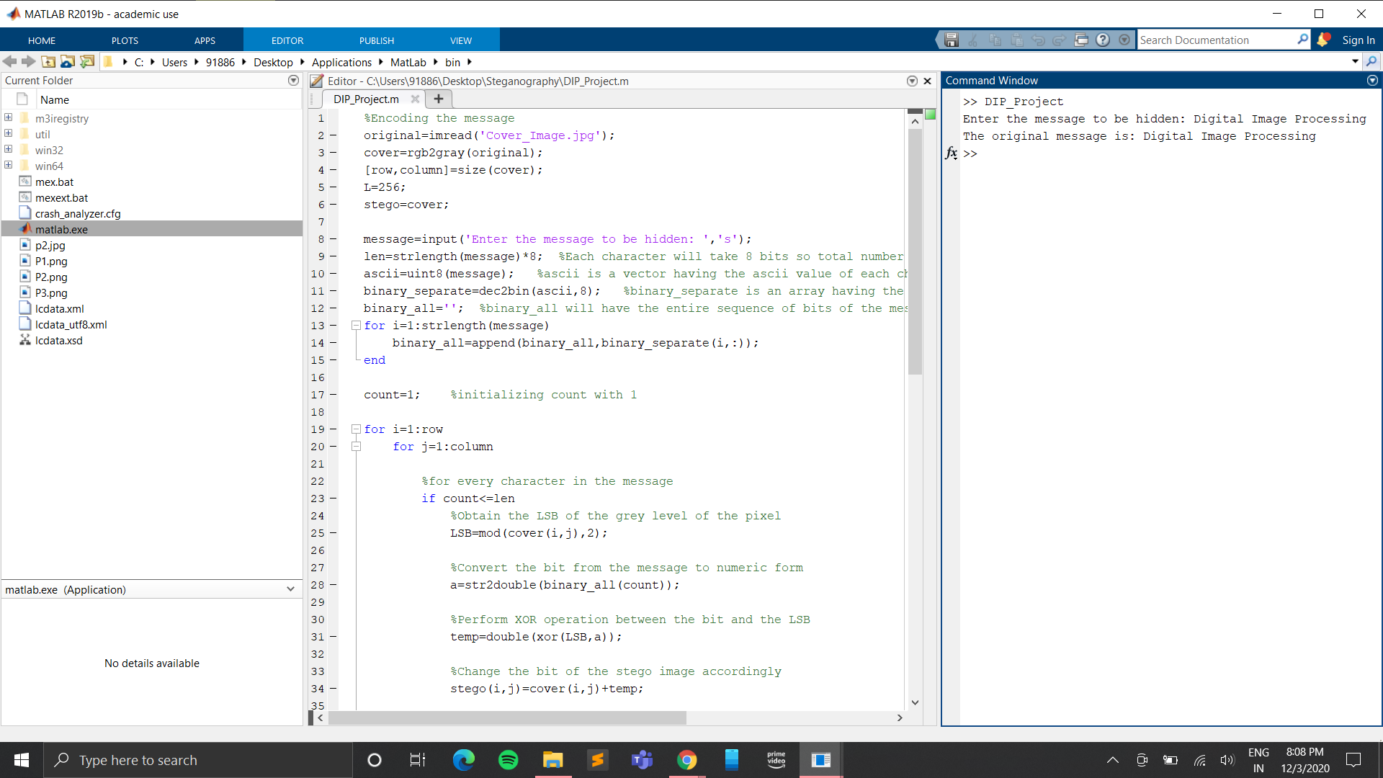
Output

Slide 9
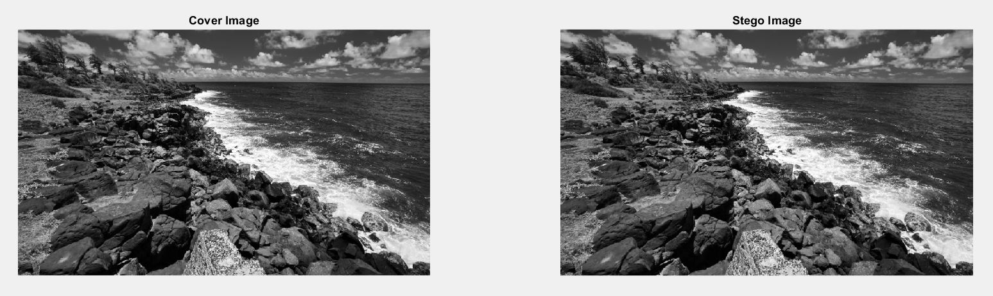
Output

Slide 10
Advantages
The output image has very slight difference to the input image.
This method is very fast and easy to implement in comparison to other methods of Image Steganography.
Instead of embedding the message in only the LSB, we can embed the message in last two LSBs, thus embedding even large messages.

Slide 11
Future Scope
Development of Algorithms based on objects in images: As the steganalysis techniques are getting stronger and eventually most steganographic algorithms are falling prey to them, there is a trend in developing algorithms which targets selective parts of images for embedding. These algorithms are called object oriented steganography. The main concept of these algorithms is to identify areas in an image also known as Region of Interests (ROI) where the embedding will cause minimum distortion.
Improving the steganographic algorithms: It is observed that all steganographic algorithms, be that in the spatial domain or the transform domain (frequency domain), ultimately alter statistical properties of images and as a result of which they fall prey to statistical steganalysis techniques. Thus, it is evident that there still remains ample scope for research in developing algorithms in image steganography that will be able to provide more secure features for data hiding.

Slide 12

Conclusion
By Conducting the experiment, we understood how data can be secretly transferred through images using steganography. We also learnt the different methods on how to perform steganography, its uses, applications,advantages and future scope. The importance of digital image processing and its wide range of applications was also noted.

